Slide 1
Amoeba -- Introduction
Amoeba 5.0 is a a general purpose distributed operating system.
  The researchers were motivated by the declining cost of CPU chips.
  They saw the challenge of designing and implementing software to manage the growing availability of computing power in a convenient way.
Basic idea
  users should not be aware of the number or location of processors, file servers, or other resources. The complete system should appear to be a single computer.
At the Free University in Amsterdam, Amoeba ran on a collection of 80 single-board SPARC computers connected by an Ethernet, forming a powerful processor pool. [Amoeba 1996 ]

Slide 2
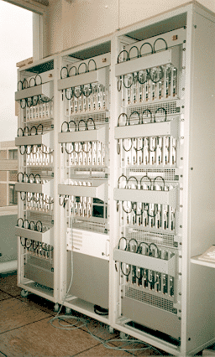
Processor Pool of 80 single-board SPARC computers.

Slide 3
Design Goals (1)
Distribution:
  Connecting together many machines so that multiple independent users can work on different projects. The machines need not be of the same type, and may be spread around a building on a LAN.
Parallelism:
  Allowing individual jobs to use multiple CPUs easily. For example, a branch and bound problem, such as the TSP, would be able to use tens or hundreds of CPUs. Chess players where the CPUs evaluate different parts of the game tree.
Transparency:
  Having the collection of computers act like a single system. So, the user should not log into a specific machine, but into the system as a whole. Storage and location transparency, just-in-time binding
Performance:
  Achieving all of the above in an efficient manner. The basic communication mechanism should be optimized to allow messages to be sent and received with a minimum of delay.Also, large blocks of data should be moved from machine to machine at high bandwidth.

Slide 4
Architectural Models
Three basic models for distributed systems: [Coulouris 1988]
1. Workstation/Server: majority as of 1988.
2. Processor pool: users just have terminals.
3. Integrated: heterogeneous network of machines that may perform both the role of server and the role of application processor.
Amoeba is an example of a hybrid system that combines characteristics of the first two models. Highly interactive or graphical programs may be run on workstations, and other programs may be run on the processor pool.

Slide 5
The Amoeba System Architecture
Four basic components:
1. Each user has a workstation running X Windows
(X11R6).
2. Pool of processors which are dynamically allocated
to users as required.
3. Specialized servers: file, directory, database, etc.
4. These components were connected to each other by a
fast LAN, and to the wide area network by a gateway.

Slide 6
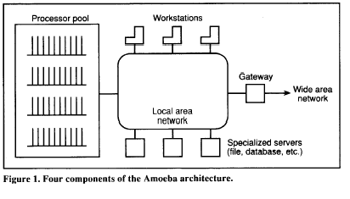

Slide 7
Micro-kernel
Provides low-level memory management. Threads and allocate or de-allocate segments of memory.
Threads can be kernel threads or User threads which are a part of a Process
Micro-kernel provides communication between different threads regardless of the nature or location of the threads
RPC mechanism is carried out via client and server stubs. All communication is RPC based in the Amoeba system

Slide 8
Microkernel and Server Architecture
Microkernel Architecture: every machine runs a small, identical
piece of software called the kernel.
The kernel supports:
1. Process, communication, and object primitives.
2. Raw device I/O, and memory management.
Server Architecture: User space server processes are built on top
of the kernel.
Modular design:
1. For example, the file server is isolated from the kernel.
2. Users may implement a specialized file server.

Slide 9
Threads
Each process has its own address space, but may contain multiple threads of control.
Each thread logically has its own registers, program counter, and stack.
Each thread shares code and global data with all other threads in the process.
For example, the file server utilizes threads.
Threads are managed and scheduled by the microkernel.
Both user and kernel processes are structured as collections of threads
communicating by RPCs.

Slide 10
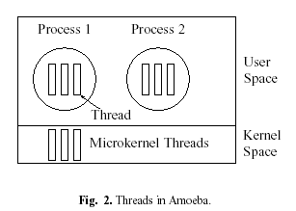

Slide 11
Remote Procedure Calls
Threads within a single process communicate via shared memory.
Threads located in different processes use RPCs.
All interprocess communication in Amoeba is based on RPCs.
A client thread sends a message to a server thread, then blocks until the server thread replies.
The details of RPCs are hidden by stubs. The Amoeba Interface Language automatically generates stub procedures.

Slide 12
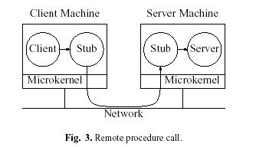

Slide 13
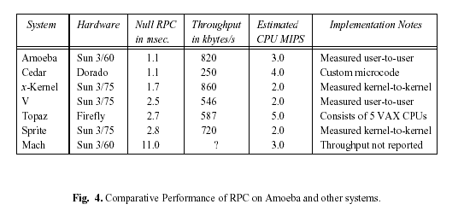
Great effort was made to optimize performance of RPCs between a client and server running as user processes on different machines.
1.1 msec from client RPC initiation until reply is received and client unblocks.

Slide 14
Objects and Capabilities
All services and communication are built around objects/capabilities.
Object: an abstract data type.
  Each object is managed by a server process to which RPCs can be sent.
  Each RPC specifies the object to be used, operation to be performed, and parameters passed.
During object creation, the server constructs a 128 bit value called a “capability” and returns it to the caller.
  Subsequent operations on the object require the user to send its capability to the server to both specify the object and prove that the user has permission to manipulate the object.

Slide 15
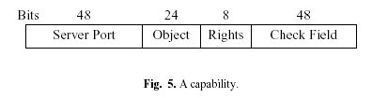
128 bit Capability
The structure of a capability:
1. Server Port identifies the server process that manages the object.
2. Object field is used by the server to identify the specific object in question.
3. Rights field shows which of the allowed operations the holder of a capability may perform.
4. Check Field is used for validating the capability.

Slide 16
Memory Management
When a process is executing, all of its segments are in memory.
No swapping or paging.
Amoeba can only run programs that fit in physical memory.
Advantage: simplicity and high performance.

Slide 17
Amoeba servers (outside the kernel)
Underlying concept: the services (objects) they provide
To create an object, the client does an RPC with appropriate server
To perform operation, the client calls the stub procedure that builds a message containing the object’s capability and then traps to kernel
The kernel extracts the server port field from the capability and looks it up in the cache to locate machine on which the server resides
If no cache entry is found-kernel locates server by broadcasting

Slide 18
Directory Server
File management and naming are separated.
  The Bullet server manages files, but not naming.
  A directory server manages naming.
Function: provide mapping from ASCII names to capabilities.
User presents a directory server with a ASCII name , capability and the server then checks the capability corresponding to the name
Each file entry in the directory has three protection domains
Operations are provided to create and delete directories . The directories are not immutable and therefore new entries can be added to directory.
User can access any one of the directory servers, if one is down it can use others

Slide 19
Boot Server
It provides fault tolerance to the system
Check if the others severs are running or not – polls server processes
A process interested in surviving crashes registers itself with the server
If a server fails to respond to the Boot server, it declares it as dead and arranges for a new processor on which the new copy of the process is started
The boot server is itself replicated to guard against its own failure

Slide 20
Bullet server
File system is a collection of server process
The file system is called a bullet server (fast: hence the name)
Files are immutable
  Once file is created it cannot be changed, it can be deleted and new one created in its place
Server maintains a table with one entry per file.
  Files are stored contiguously on disk - Caches whole files contiguously in core.
Usually, when a user program requests a file, the Bullet server will send the entire file in a single RPC (using a single disk operation).
Does not handle naming. Just reads and writes files according to their capabilities.
  When a client process wants to read a file it send the capability for the file to server which in turn extracts the object and finds the file using the object number
Operations for managing replicated files in a consistent way are provided.

Slide 21
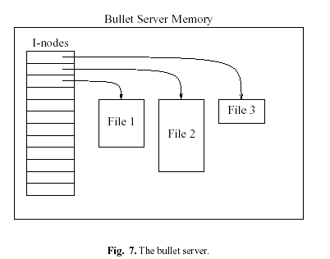

Slide 22
Group Communication
One-to-Many Communication:
A single server may need to send a message to a group of cooperating servers when a data structure is updated.
Amoeba provides a facility for reliable, totally-ordered group
communication.
All receivers are guaranteed to get all group messages in exactly the same order.

Slide 23
Software Outside the Kernel
Additional software outside the kernel includes:
1. Compilers: C, Pascal, Modula 2, BASIC, and Fortran.
2. Orca for parallel programming.
3. Utilities modeled after UNIX commands.
4. UNIX emulation.
5. TCP/IP for Internet access.
6. X Windows.
7. Driver for linking into a SunOS UNIX kernel.

Slide 24
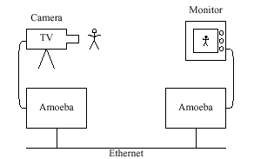
Applications
Use as a Program development environment-it has a partial UNIX emulation library. Most of the common library calls like open, write, close, fork have been emulated.
Use it for parallel programming-The large number of processor pools make it possible to carry out processes in parallel
Use it in embedded industrial application as shown in the diagram below

Slide 25
Amoeba – Lessons Learned
After more than eight years of development and use, the researchers
assessed Amoeba. [Tanenbaum 1990, 1991]. Amoeba has demonstrated that it is possible to build a efficient, high performance distributed operating system.
Among the things done right were:
The microkernel architecture allows the system to evolve as needed.
Basing the system on objects.
Using a single uniform mechanism (capabilities) for naming and protecting objects in a location independent way.
Designing a new, very fast file system.
Among the things done wrong were:
1. Not allowing preemption of threads.
2. Initially building a window system instead of using X Windows.
3. Not having multicast from the outset.

Slide 26
Future
Desirable properties of Future systems
Seamless distribution-system determines where computation excuet and data resides. User unaware
Worldwide scalability
Fault Tolerance
Self Tuning-system takes decision regarding the resource allocation, replication, optimizing performance and resource usage
Self configurations-new machines should be assimilated automatically
Security
Resource controls-users has some controls over resource location etc
A Company would not want its financial documents to be stored in a location outside its network system

Slide 27
References
[Coulouris 1988] Coulouris, George F., Dollimore, Jean:
Distributed Systems: Concepts and Design, 1988
[Tanenbaum 1990] Tanenbaum, A.S., Renesse, R. van, Staveren, H. van.,
Sharp, G.J., Mullender, S.J., Jansen, A.J., and Rossum, G. van:
"Experiences with the Amoeba Distributed Operating System,"
Commun. ACM, vol. 33, pp. 46-63, Dec. 1990
[Tanebaum 1991]
Tanenbaum, A.S., Kaashoek, M.F., Renesse, R. van, and Bal, H.:
"The Amoeba Distributed Operating System-A Status Report,"
Computer Communications, vol. 14, pp. 324-335, July/August 1991.
[Amoeba 1996]
The Amoeba Distributed Operating System,
http://www.cs.vu.nl/pub/amoeba/amoeba.html

Slide 28
Chorus Distributed OS - Goals
Research Project in INRIA (1979 – 1986)
Separate applications from different suppliers running on different operating systems
  need some higher level of coupling
Applications often evolve by growing in size leading to distribution of programs to different machines
  need for a gradual on-line evolution
Applications grow in complexity
  need for modularity of the application to be be mapped onto the operating system concealing the unnecessary details of distribution from the application

Slide 29
Chorus – Basic Architecture
Nucleus
  There is a general nucleus running on each machine
  Communication and distribution are managed at the lowest level by this nucleus
  CHORUS nucleus implements the real time required by real time applications
Traditional operating systems like UNIX are built on top of the Nucleus and use its basic services.

Slide 30
Chorus versions
    Chorus V0 (Pascal implementation)
      Actor concept - Alternating sequence of indivisible execution and communication phases
      Distributed application as actors communicating by messages through ports or groups of ports
      Nucleus on each site
    Chorus V1
      Multiprocessor configuration
      Structured messages, activity messages
    Chorus V2, V3 (C++ implementation)
      Unix subsystem (distant fork, distributed signals, distributed files)

Slide 31
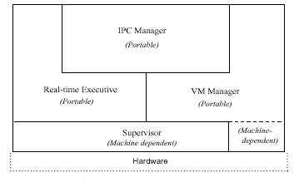
Nucleus Architecture

Slide 32
Chorus Nucleus
Supervisor(machine dependent)
  dispatches interrupts, traps and exception given by hardware
Real-time executive
  controls allocation of processes and provides synchronization and scheduling
Virtual Memory Manager
  manipulates the virtual memory hardware and and local memory resources. It uses IPC to request remote date in case of page fault
IPC manager
  provides asynchronous message exchange and RPC in a location independent fashion.
Version V3 onwards, the actors , RPC and ports management were made a part of the Nucleus functions

Slide 33
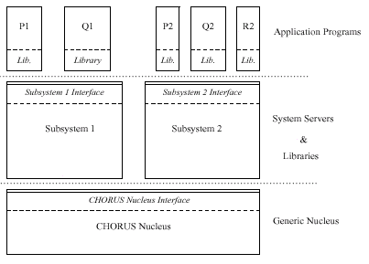
Chorus Architecture
The Subsystems provide applications with with traditional operating system services
Nucleus Interface
  Provides direct access to low-level services of the CHORUS Nucleus
Subsystem Interface
  e.g.. UNIX emulation environment, CHORUS/MiX
  Thus, functions of an operating system are split into groups of services provided by System Servers (Subsystems)
User libraries – e.g. “C”

Slide 34
Chorus Architecture (cont.)
System servers work together to form what is called the subsystem
The Subsystem interface –
  implemented as a set of cooperating servers representing complex operating system abstractions
Note: the Nucleus interface Abstractions in the Chorus Nucleus
  Actor-collection of resources in a Chorus System.
    It defines a protected address space. Three types of actors-user(in user address space), system and supervisor
  Thread
  Message (byte string addressed to a port)
  Port and Port Groups -
    A port is attached to one actor and allows the threads of that Actor to receive messages to that port
  Region
Actors, port and port groups have UIs

Slide 35
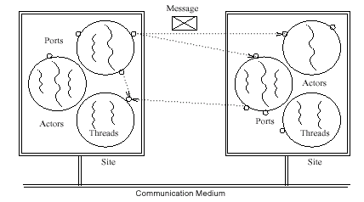
Actors
* trusted if the Nucleus allows to it perform sensitive Nucleus Operations
* privileged if allowed to execute privileged instructions.
User actors - not trusted and not privileged
System actors - trusted but not privileged
Supervisor actor – trusted and privileged

Slide 36
Actors ,Threads and Ports
A site can have multiple actors
Actor is tied to one site and its threads are always executed on that site
Physical memory and data of the thread on that site only
Neither Actors nor threads can migrate to other sites.
Threads communicate and synchronize by IPC mechanism
However, threads in an actor share an address space
  can use shared memory for communication
An Actor can have multiple ports.
  Threads can receive messages on all the ports.
  However a port can migrate from one actor to another
Each Port has a logical and a unique identifier

Slide 37
Regions and Segments
An actors address is divided into Regions
A region of of an actor’s address space contains a portion of a segment mapped to a given virtual address.
Every reference to an address within the region behaves as a reference to the mapped segment
The unit of information exchanged between the virtual memory system and the data providers is the segment
Segments are global and are identified by capabilities(a unit of data access control)
A segment can be accessed by mapping (carried by Chorus IPC) to a region or by explicitly calling a segment_read/write system call

Slide 38
Messages and Ports
A message is a contiguous byte string which is logically copied from the sender’s address space to the receiver’s address space
Using coupling between large virtual memory management and IPC large messages can be transferred using copy-on-write techniques or by moving page descriptors
Messages are addressed to PoRts and not to actors. The port abstraction provides the necessary decoupling of the interface of a service and its implementation
When a port is created the Nucleus returns both a local identifier and a Unique Identifier (UI) to name the port

Slide 39
Port and Port Groups
Ports are grouped into Port Groups
When a port group is created it is initially empty and ports can be added or deleted to it.
A port can be a part of more than one port group
Port groups also have a UIs

Slide 40
Segment representation within a Nucleus
Nucleus manages a per-segment local cache of physical pages
Cache contains pages obtained from mappers which is used to fulfill requests of the same segment data
Algorithms are required for the consistency of the cache with the original copies
Deferred copy techniques is used whereby the Nucleus uses the memory management facilities to avoid performing unnecessary
copy operations

Slide 41
Chorus Subsystem
A set of chorus actors that work together to export a unified application programming interface are know as subsystems
Subsystems like Chorus/MiX export a high-level operating system abstractions such as process objects, process models and data providing objects
A portion of a subsystem is implemented as a system actor executing in system space and a portion is implemented as user actor
Subsystem servers communicate by IPC
A subsystem is protected by means of system trap interface

Slide 42
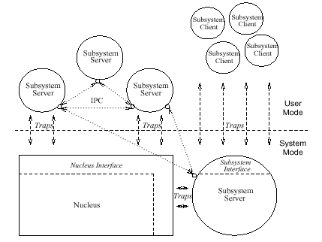

Slide 43
CHORUS/MiX: Unix Subsystem
Objectives: implement UNIX services, compatibility with existing application programs, extension to the UNIX abstraction to distributed environment, permit application developers to implement their own services such as window managers
The file system is fully distributed and file access is location independent
UNIX process is implemented as an Actor
Threads are created inside the process/actor using the u_thread interface.
  Note: these threads are different from the ones provided by the nucleus
Signals to are either sent to a particular thread or to all the
threads in a process

Slide 44
Unix Server
Each Unix Server is implemented as an Actor
It is generally multithreaded with each request handled by a thread
Each server has one or more ports to which clients send requests
To facilitate porting of device drivers from a UNIX kernel into the CHORUS server, a UNIX kernel emulation emulation library library is developed which is linked with the Unix device driver code.
Several types of servers can be distinguished in a subsystem: Process Manager(PM), File Manager (FM), Device Manager (DM)
IPC Manager (IPCM)

Slide 45
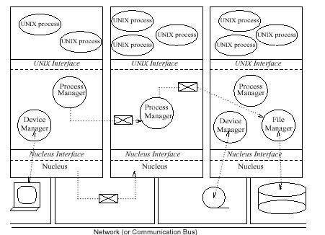
Chorus/Mix: Unix with chorus

Slide 46
Process Manager (PM)
It maps Unix process abstractions onto CHORUS abstractions
It implements entry points used by processes to access UNIX services
For exec, kill etc the PM itself satisfies the request
For open, close, fork etc it invokes other subsystem servers to handle the request
PM accesses the Nucleus services through the system calls
For other services it uses other interfaces like File manager, Socket Manager, Device Manager etc

Slide 47
UNIX process
A Unix process can be view as single thread of control mapped into a single chorus actor whose Unix context switch is managed by the Process Manager
PM also attaches control port to each Unix process actor. A control thread is dedicated to receive and process all messages on this port
For multithreading the UNIX system context switch is divide into two subsystems: process context and u_thread context

Slide 48
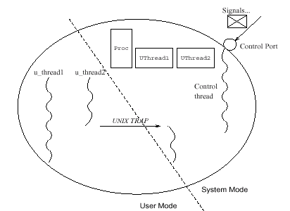
Unix process as a Chorus Actor

Slide 49
File Manager (FM)
It provides disk level UNIX file system and acts as mappers to the Chorus Nucleus
FM implements services required by CHORUS virtual memory management such as backing store.

